Slide 1

Objects
Using a Simple Class

Slide 2
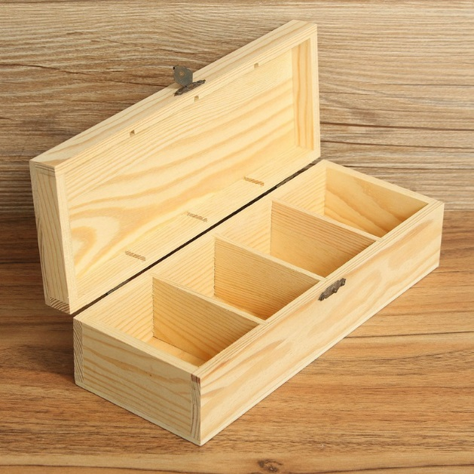
Learning Objectives
Last Few Topics
Variables : float, color, boolean
Animation and Interaction
Events
Conditional statements – if, else if, else
Functions, parameter passing
Learning Objectives
Using a simple class
Class defines new TYPE
Object is the variable of type Class
constructors
methods
Object -Variable
(with many compartments)

Slide 3
Animating Multiple Objects
When we animate an object, we need to store what information?
Where it is (x,y), how it moves – direction (dx, dy)
Every 2-dimensional animated object needs, at least, these
four variables:
float x; //(x, y) is the position
float y; //of the object
float dx; //speed along the x-axis
float dy; //speed along the y-axis
So, if you want to animate 3 different objects, you will need at least 12 variables:
float x1; //object 1
float y1;
float dx1;
float dy1;
Dealing with so many similarly-named variables is quite difficult in practice. It’s easy to write y2 instead of y1.
(x, y)
dx,
dy
float x2; //object 2
float y2;
float dx2;
float dy2;
float x3; //object 3
float y3;
float dx3;
float dy3;

Slide 4
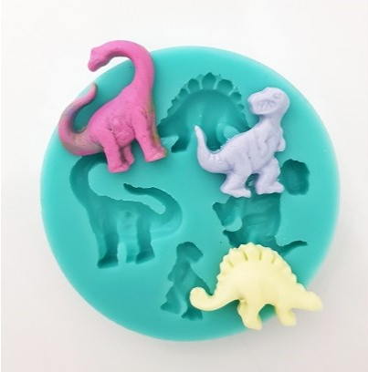
Introduction to a Class
To deal with this complexity we group our variables x, y, dx, and dy together into an Object.
To do this in Java, create a class:
class Sprite {
float x;
float y;
float dx;
float dy;
}
A bit like a collection of information about a single thing.
Class description – template for what these objects should contain
Using the Sprite class, we can now create Sprite objects like this:
Sprite ball = new Sprite();
ball.x = 40;
…
Sprite box = new Sprite();
x
y
dx
dy
mould

Slide 5
Using the Sprite Class
Calling
mySprite = new Sprite();
creates a new object that contains its own x, y, dx, and dy values.
We can set or get them like this:
ball.x = 10; // initialize ball
ball.y = 10;
ball.dx = 1;
ball.dy = 1.5;
box.x = 450; // initialize box
box.y = 450;
box.dy = -1;
ball.dx = box.dy; what effect?
class Sprite {
float x;
float y;
float dx;
float dy;
}
Sprite box, ball;
void setup()
{
box = new Sprite();
ball = new Sprite();
}
Class members
ball
x:10
y:10
dx:1
dy:1.5
dx:-1
box
x:450
y:450
dx:
dy:-1
set y in ball to 5.
set dx in box to 1
Dot means open the object and
access one of its member variables

Slide 6
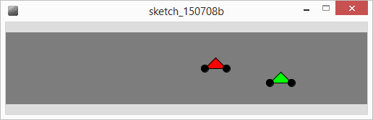
Simple Class
We can define class(es) to represent most problems (graphical and non-graphical)
Define new class(es) with different names
Exercise : motorbike race
What information would we need for a motorbike?
Write a motorbike class.

Slide 7
Class motorbike
colour as well
Need x position – will change
Need y position – fixed for a bike
Speed – change in x
Declare 2 instances of the class
As yet no actual box (memory)
In setup let’s create the memory using new
class Motorbike {
}
Motorbike
void setup()
{
}

Slide 8
Drawing a bike
We could use an existing procedure to draw our motorbikes at a particular place
What would the line of code be to draw motorbike b1, pass 30 for the size?
Better to have the Motorbike take care of its own drawing (behaviours)
Example b1.render(); would draw bike b1, in b1’s current position
b2.render(); would draw bike b2, in b2’s current position
position stored in
object anyway
void draw()
{
background(125);
drawMotorbike(b1.x, b1.y, 30);
…
}
void drawMotorbike(int x, int y, int size)
{
float wheelHeight = size/3;
triangle(x,y,x+size,y,x+size/2,y-size/2);
ellipse(x,y,wheelHeight,wheelHeight);
ellipse(x+size,y,wheelHeight,wheelHeight);
}

Slide 9
Adding Methods
So far Class information consists of
where it is and direction information
Called Members
Member, an attribute of a class containing a value
We can also add Procedures & Functions to Class descriptions
Called Methods
Methods are functions (or Procedures) which tell a class how to behave
E.g. Draw itself – render
The class contains all the information about itself already
Makes sense to use it directly

Slide 10
Render Method
void draw()
{
background(125);
b1.render();
b1.x= b1.x + b1.speed;
b2.render();
b2.x=b2.x + b2.speed;
}
class Motorbike {
int x = 5;
int y;
int speed=5;
int size=30;
void render()
{
float wHeight = size/3;
triangle(x,y,x+size,y,x+size/2,y-size/2);
ellipse(x,y,wHeight,wHeight); ellipse(x+size,y,wHeight,wHeight);
}
}
Information in class
No need for parameters
Do same thing for move

Slide 11
Move Method
Add move method to our class & how would we use it?
void draw()
{
background(125);
b1.render();
b1.move();
b2.render();
b2.move();
}
class Motorbike {
int x = 5;
int y;
int speed=5;
int size=30;
void move()
{
}
void render()

Slide 12
Constructors
A special method, called when using the new command
Motorbike b1; //declare an instance of motorbike class
b1 = new Motorbike();
We can pass parameters to set member variable values
We might want to initialise y and speed values for motorbike
b1 = new Motorbike(50, 5);
50 passed to y, 5 passed for speed

Slide 13
Example Constructor
Motorbike b1,b2;
Motorbike b3;
void setup()
{
b1 = new Motorbike(50,5);
b2 = new Motorbike(70,3);
}
class Motorbike {
int x = 5;
int y;
int speed;
int size=30;
Motorbike( int y, int speed)
{
this.y = y;
this.speed = speed;
}
void move()
void render()
}
Constructor has same name
(return type) as class
this refers to variable
(member) within the class
Add a new instance of Motorbike at 100 y, with speed 2

Slide 14
Function Methods
Our methods can handle behaviours
e.g. render();
Function methods can report – provide information
Racing motorbikes – might need to know if bike has reached the finish
Function returns a value
Finished() - type boolean – returns true or false
Should return true if bike has reached right hand side of screen

Slide 15
Finished function method
boolean finished(int finishLine)
{
if (speed>0) //heading right
return x >= finishLine; //left to right
else
return x <= finishLine; //heading left
}
if (b1.finished(490) == false)
b1.move();
x position of finish line
Add to motorbike class
Use within draw()

Slide 16
Exercise
Write a function called travelLeft which returns true if the bike is travelling right to left and false otherwise
Use sign of speed
What return type? Any parameters required?

Slide 17
Summary
Class – template for an object, description of variables (class members – the mould)
Object – Variable with sub compartments - members
Methods – functions (procedures) how to use the class
Constructor – special method called on NEW command
Parameters – passing values to methods
A Class can have many constructors – must take different parameters

